Slide 1
Combinatorics

Slide 2
Reading
zyBook:
Chapter 13.1-13.12
Chapter 14.1-14.3

Slide 3
What is combinatorics?
Science of counting!
How many ways can ways can five horses finish a race, assuming no ties?
How many socks to you need to pull out of a drawer to ensure you have a match?
How many ways can you do six errands?

Slide 4
Why in CS?
Computer Science of counting!
How many ways can five processes finish running, assuming no ties?
How many passwords do you need to try to break into the system?
How many ways can you test six features to ensure they do not conflict?
How many different ways can I choose two pieces of the road network to break in a simulation?

Slide 5
Single Choice
Player’s Guide 1:
8 Roles
Player’s Guide 2:
8 Roles
Player’s Guide 3:
6 Roles
A
B
C

Slide 6
Sum Rule
|A| = 8
|B| = 8
|C| = 6
Total number of outcomes = |A|+|B|+|C| = 22
|A U B U C| = 22

Slide 7
Multiple Single Choices
Player 2
Player 1
Player 3

Slide 8
Product Rule
|A| = 8
|B| = 8
|C| = 6
Total number of outcomes = |A|*|B|*|C| = 384
|A X B X C| = 384

Slide 9
Pooling Resources
Player 2
Player 1
Player 3

Slide 10
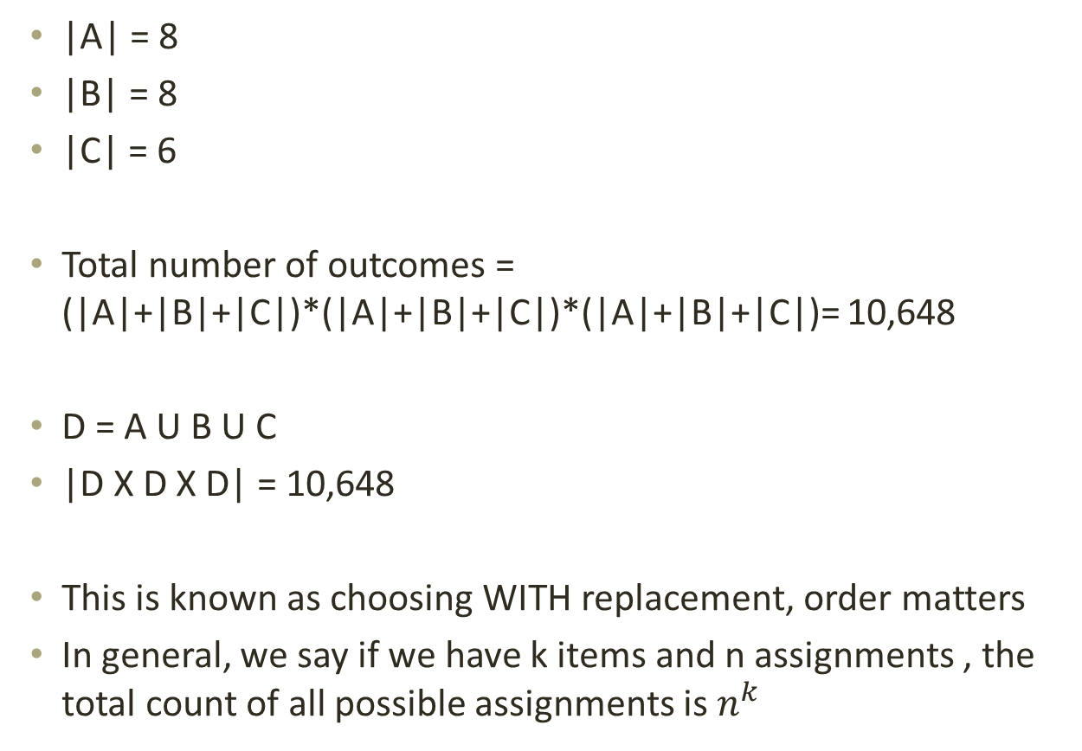
Combined
|A| = 8
|B| = 8
|C| = 6
Total number of outcomes = (|A|+|B|+|C|)*(|A|+|B|+|C|)*(|A|+|B|+|C|)= 10,648
D = A U B U C
|D X D X D| = 10,648
This is known as choosing WITH replacement, order matters
In general, we say if we have k items and n assignments , the total count of all possible assignments is $n^{k}$

Slide 11
Possible Assignments
|A| = 8
|B| = 8
|C| = 6
|R| = 29
Total number of outcomes = ((|A|+|B|+|C|)*|R|)*((|A|+|B|+|C|)*|R|)*((|A|+|B|+|C|)*|R|) = 259,694,072
OR (22*29)³
Party of 4
(22*29)⁴ = 165,684,817,936

Slide 12
Computer Memory
Given 32 bits, how many different bit strings can be produced?
Addresses for memory cells
32 different bits
2 possible assignments for each of them (0,1)
2³² = 4,294,967,296 bit strings
Roughly 4 billion
2⁶⁴ = 18,446,744,073,709,551,616 bit strings
Roughly 18 quintillion bit strings!

Slide 13
IP Addresses
IPv4: 129.120.65.162
4 positions, each with a possible value of 0-255
How many possible different IPv4 addresses can you form?
256⁴ = 4,294,967,296
What about IPv6?
256⁶ = 281,474,976,710,656

Slide 14
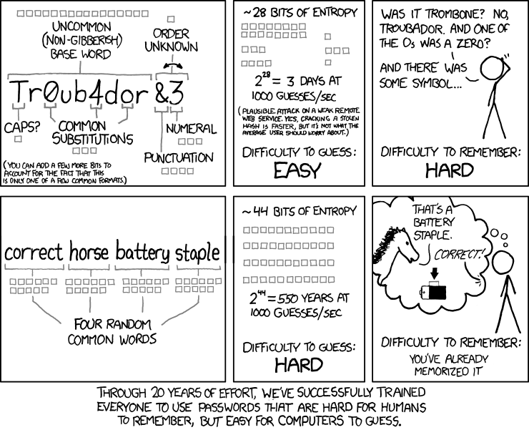
Security
https://xkcd.com/936/

Slide 15
Passwords
26+26+10+15 = 77
Password length: 8 characters
77⁸ = 1,235,736,291,547,681 different combinations
26 lower case letters only
Password length: 25 characters
26²⁵ = 236,773,830,007,967,588,876,795,164,938,469,376
different combinations

Slide 16
Choosing Without Replacement
Permutations
Unordered Selections
Ordered Selections

Slide 17
Counting Permutations
Marching order for n party members
4 party members:
4 choices for the first position
3 choices for the second position
2 choices for the third position
1 choices for the fourth position
4*3*2*1 = 24 possible orderings
4*3*2*1 = 4!
Each different way of ordering n things is called a permutation of n.
P(n) = n!

Slide 18
Counting Selections
5 party members, but only 3 are travelling:
5 choices for the first position
4 choices for the second position
3 choices for the third position
We do not worry about the people who are not included
5*4*3 = 60
(5*4*3*2*1)/(2*1) = 5!/(5-3)!
Ordered Selections
P(n,m) = n!/(n-m)!
We call this selection WITHOUT replacement, order matters

Slide 19
Tarot Readings
How many unique, traditional three-card readings could a single person get?
22 major arcana cards + 56 minor arcana cards = 76 total cards
P(76,3) = 76!/(76-3)! = 421,800
Unique Celtic Cross spreads (10 cards)?
22 major arcana cards + 56 minor arcana cards = 76 total cards
P(76,10) = 76!/(76-10)! = 3,463,786,592,489,664,000

Slide 20
Computer Scheduling
15 unique, equal processes, but only enough RAM to run 5
Schedule:
P(15,5) = 15!/(15-5)! = 360,360
Need more RAM!
4 RAM slots and 20 unique, chips to choose from
P(20,4) = 20!/(20-4)! = 116,280

Slide 21
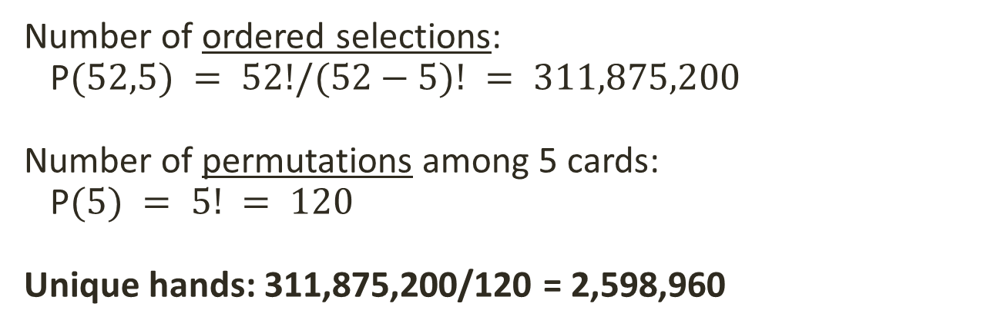
Poker Hands
Each player receives 5 cards from a 52-card deck
How many different hands may we receive?
What do we need to calculate?
Ordered or unordered selection?
Number of ordered selections: P$(52,5) = 52!/(52−5)! = 311,875,200$
Number of permutations among 5 cards: P$(5) = 5! = 120$
Unique hands: 311,875,200/120 = 2,598,960

Slide 22
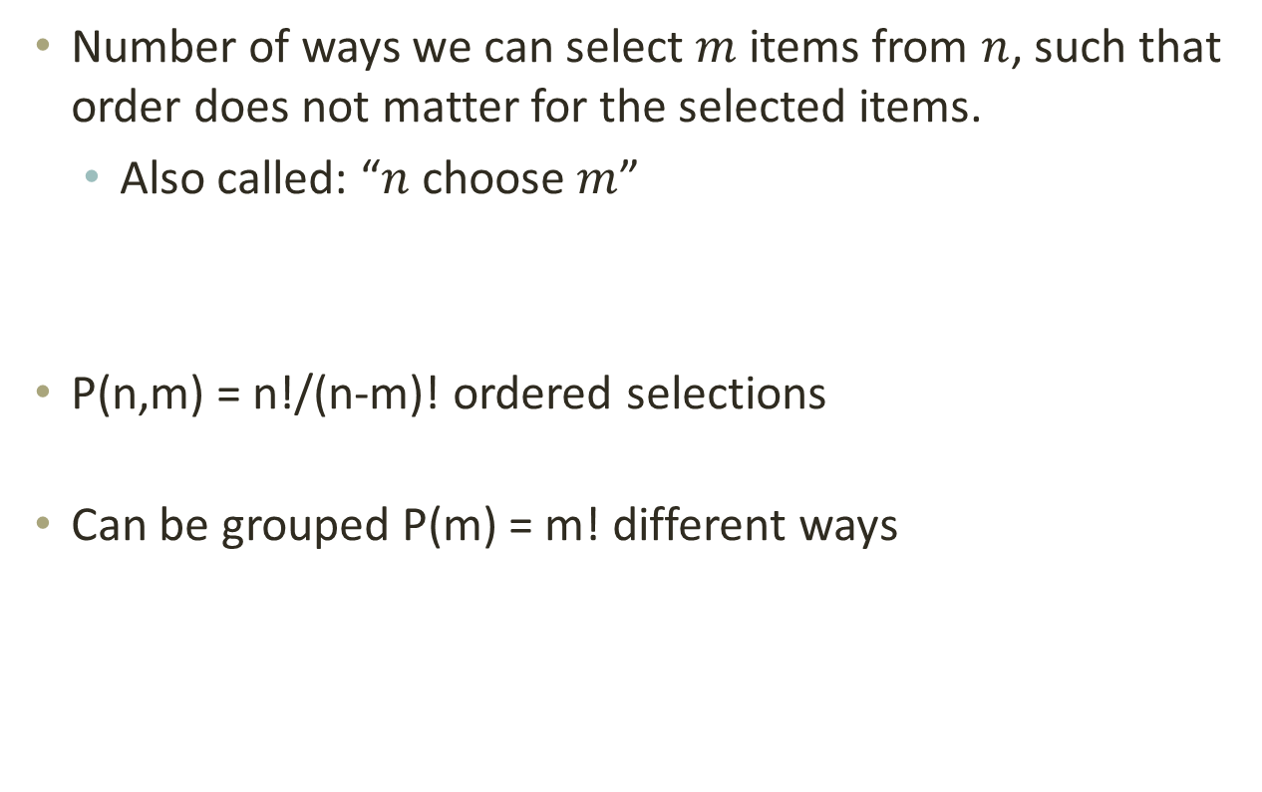
Unordered Selections
Number of ways we can select $m$ items from $n$, such that order does not matter for the selected items.
Also called: “$n$ choose $m$”
P(n,m) = n!/(n-m)! ordered selections
Can be grouped P(m) = m! different ways

Slide 23

Counting Cards
Poker example:

Slide 24
Identical Items and Objects to Bins
Ordering with Identical Items
Distributing Objects to Bins

Slide 25
Anagrams
Some items are identical
If items are distinguishable, order does matter!
Example: abenst (answer: absent)
P(6) = 6! = 720 permutations
Example: eilltt
P(6) = 6! = 720 permutations
“l” counted double: 720/2 = 360 permutations
“t” counted double: 360/2 = 180 permutations

Slide 26

Ordering with Identical Items
If there are n items divided into k groups of sizes i1, i2, ..., ik, items within a group are not distinguishable, but items from different groups are distinguishable, then the number of distinguishable orders of the n items is:

Slide 27
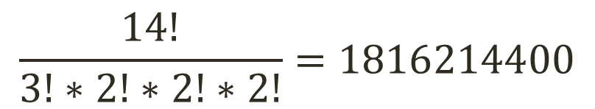
Example
adenocarcinoma
Length: 14
a: 3 times
n: 2 times
c: 2 times
o: 2 times
$$\frac{14!}{3!∗2!∗2!∗2!}=1816214400$$

Slide 28
Distribution of Potions
Suppose we have 3 party members and 4 healing potions. In how many ways can we distribute the potions?
(0,0,4) | (0,1,3) | (0,2,2) | (0,3,1) | (0,4,0)
(1,0,3) | (1,1,2) | (1,2,1) | (1,3,0)
(2,0,2) | (2,1,1) | (2,2,0)
(3,0,1) | (3,1,0)
(4,0,0)
**PPPP | *P*PPP | *PP*PP | *PPP*P | *PPPP*
P**PPP | P*P*PP | P*PP*P | P*PPP*
PP**PP | PP*P*P | PP*PP*
PPP**P | PPP*P*
PPPP**

Slide 29
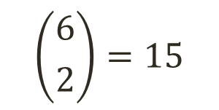
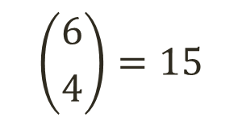
Distribution of Symbols/Delimiters
**PPPP | *P*PPP | *PP*PP | *PPP*P | *PPPP*
P**PPP | P*P*PP | P*PP*P | P*PPP*
PP**PP | PP*P*P | PP*PP*
PPP**P | PPP*P*
PPPP**
Unique distribution of 4 Ps and 2 *s
$$\left({6 \atop 4}\right)=15$$
$$\left({6 \atop 2}\right)=15$$

Slide 30

Distribution of Objects to Bins
We are given m bins and n identical objects.
How many ways can the objects be put into the bins?
We have n P’s for the objects and (m-1) *’s as separators between the bins. This gives us a string of length (n+m-1).
Now we can choose n out of the (n+m-1) places to hold the Ps.

Slide 31

Casting Dice
Example: Chuck-a-Luck: 3 dice numbered from 1 to 6. Players bet a dollar on a number.
Each player receives as many dollars as his or her number shows. How many different outcomes are there?
The dice are indistinguishable. The order does not matter. The numbers 1-6 act as “bins”. The dice are objects distributed to them.

Slide 32
Distinguishable Objects to Bins
Distinguishable Objects to Bins
Summary

Slide 33
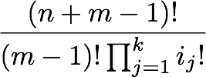
Distinguishable Objects & Bins
Distribute n objects into m bins. There are k different types of objects.
Let i_{j} represent the members of class j.
Generate a string with
one i_{j} for each member of class i
*’s for boundaries between bins
e.g. for k=3 , n=6 , m = 4 : i1i3*i1*i2*i2i1
So we have n objects with group sizes 3, 2 and 1, and one additional class of *s with m-1 members.

Slide 34
Distinguishable Potions
Example:
3 party members
3 lesser healing, 2 healing, 1 greater healing
m = 3, n = 6,
k = 3 with i1 = 3, i2 = 2, i3 = 1

Slide 35

Summary 1/2
n assignments to k items:
n^{k}
Permutations of n elements: P(n) = n!
Ordered selection (m out of n elements): P(n,m) = n!/(n-m)!
Unordered selection (“n choose m”):

Slide 36
Summary 2/2
Ordering with identical items
Distribution of objects to bins
Distribution of distinguishable objects to bins

Slide 37


Pigeonhole Principle
If n items are to be placed into m pigeonholes with n > m, then at least one pigeonhole must contain more than one item.

Slide 38
Hairy Situation
In Los Angeles there must be at least two people with the same number of hairs on their heads.
Los Angeles has more than 1 million people.
Each individual has a certain number of hairs on their head. (hair count = pigeonhole)
A typical person has about 100,000 hairs on their head. No one should have more than 1 million head hairs.
Since there are less than 1 million pigeonholes, there will be more than one individual with a specific number of head hairs.

Slide 39
Dirichlet’s Box
So what is so special about this observation?
This principle, also known as Dirichlet’s box, is of importance in Ramsey Theory.
“How many elements of some structure must there be to guarantee that a particular property will hold?”
It can be used to test combinatorial results that are not as obvious as the pigeonhole principle itself.
Given a hash table of size m, and n unique keys used to index values, if n > m then a collision must occur.

